Slide 1
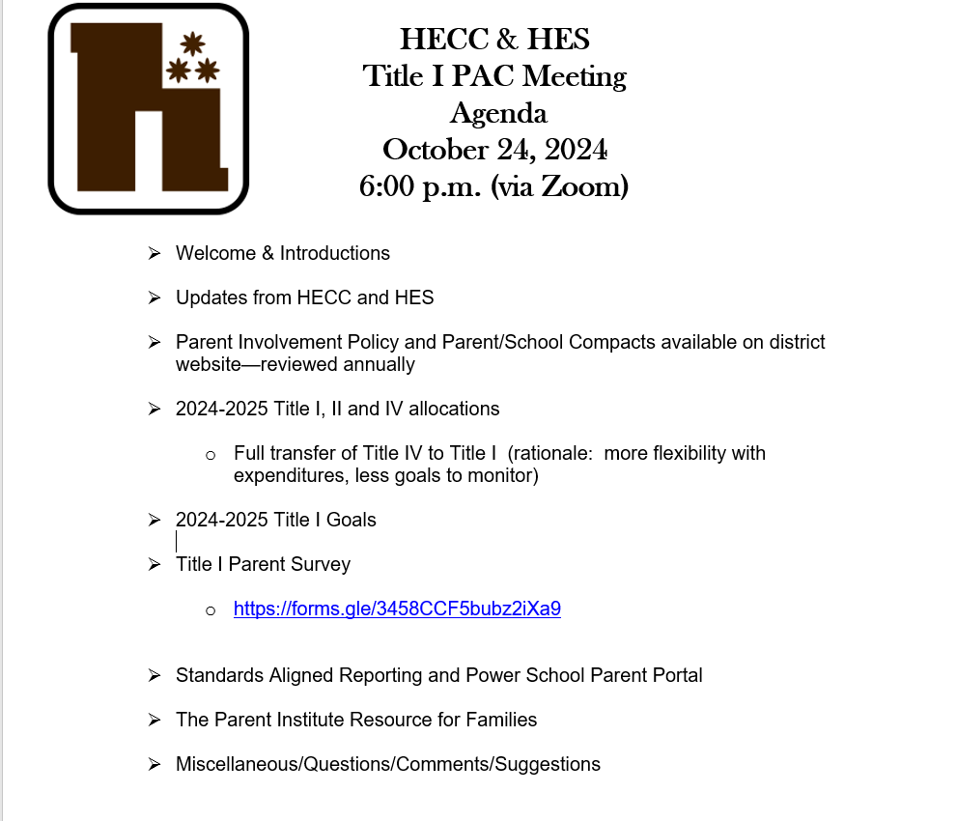

Slide 2
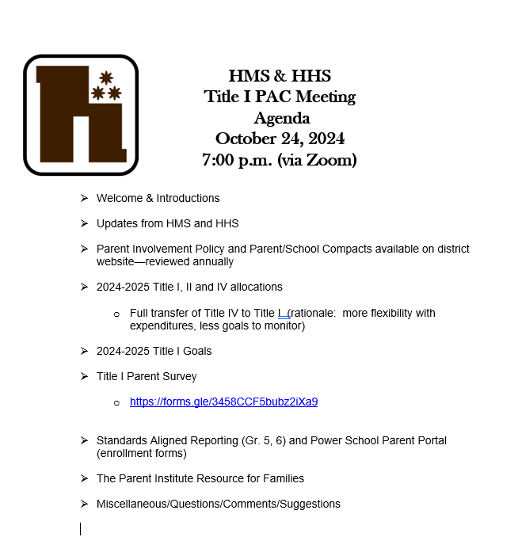

Slide 3
2024-2025 FEDERAL FUNDS
All Highlands schools have Schoolwide Title I programs
TITLE I--$1,108,928
Salaries/Benefits for 5 MTSS teachers, Student Services Coordinator
Non Public Title I Student Services
Curriculum Resources
Star 360, Acadience, Freckle
Accelerated Reader, Spring Math
Fluency & Fitness, iCEV
Family Engagement Activities
Camp Creativity
PBIS incentives
Technology Supplies
MTSS Supplies
TITLE II--$112,426
Professional Development
Common assessments
Standards aligned reporting
Data informed instruction
Technology integration
Non Public Schools Professional Development
TITLE IV--$84,488
Professional Development
PA STEELS standards
Career & Workforce
Readiness
World of Work
Reading Achievement
Center
NOTE: We are transferring all Title IV funds to Title I
Intag Aquaponics

Slide 4
2024-2025 Title I Goals
  HES
    Math achievement—70% proficient/advanced on Star Math by end of year
    ELA achievement—70% proficient/advanced on Star Reading by end of year
    Regular Attendance for Grades 1-4—78% by end of year
  HECC
    Increase regular attendance for all students, students with disabilities, and 2 or more races by 8%.
    Increase parent/family engagement opportunities by 10%

Slide 5
2024-2025 Title I Goals
  HMS
    Math achievement—60% proficient/advanced on Star Math by end of year in Algebraic Concepts
    ELA achievement—70% proficient/advanced on Star Reading by end of year
    Regular Attendance—94% by end of year
  HHS
    Full implementation of Advanced Tiers of PBIS by end of year
    Biology achievement—35% proficient/advanced for students with disabilities by end of year
    Algebra achievement—20% proficient/advanced for students with disabilities by end of year

Slide 6
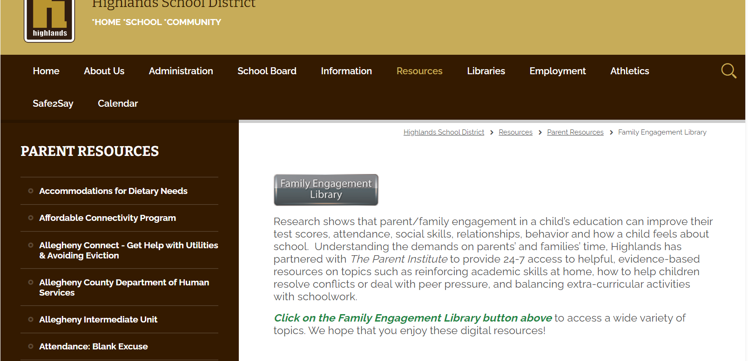
Family Engagement Library

Slide 7
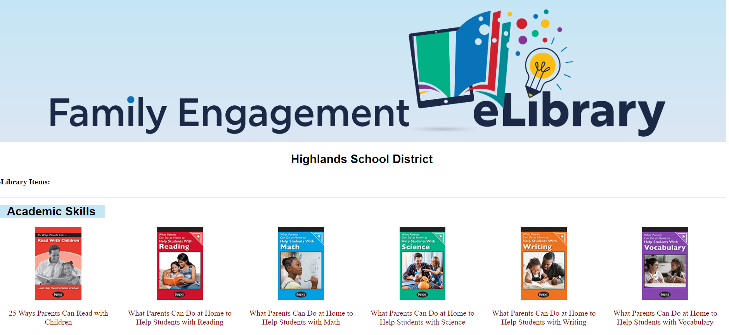
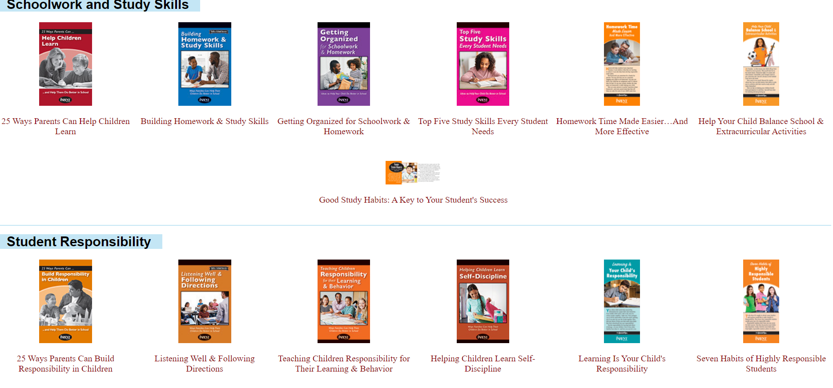


Slide 8

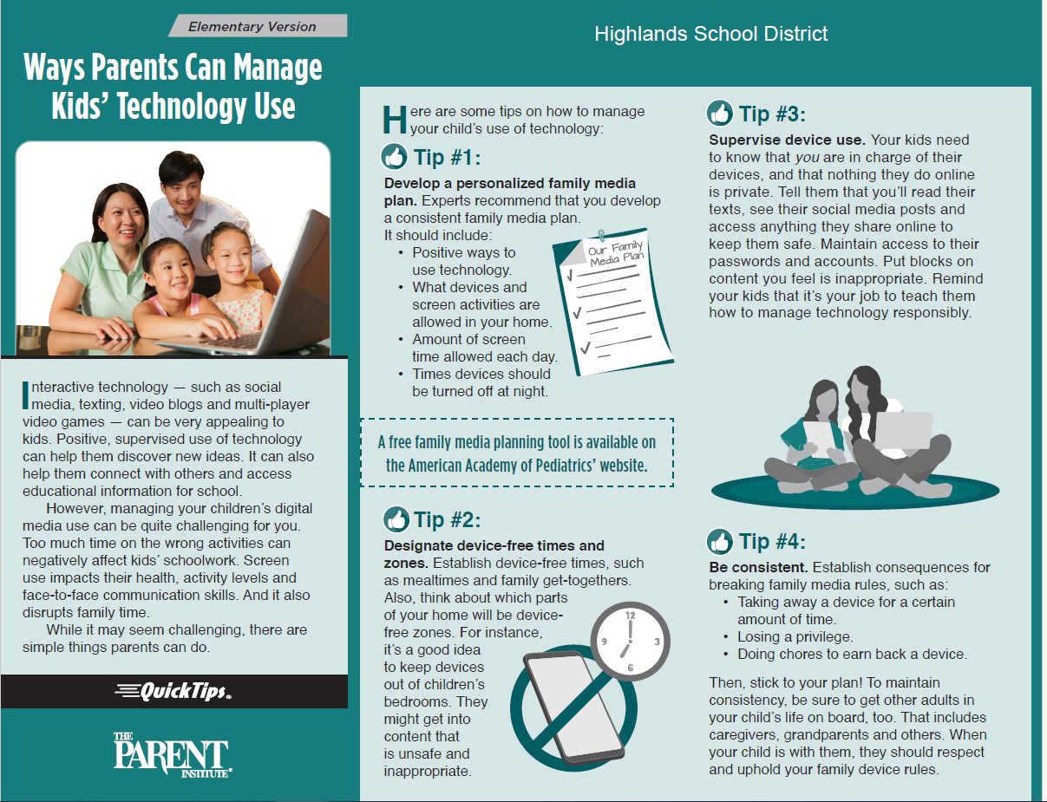

Slide 9
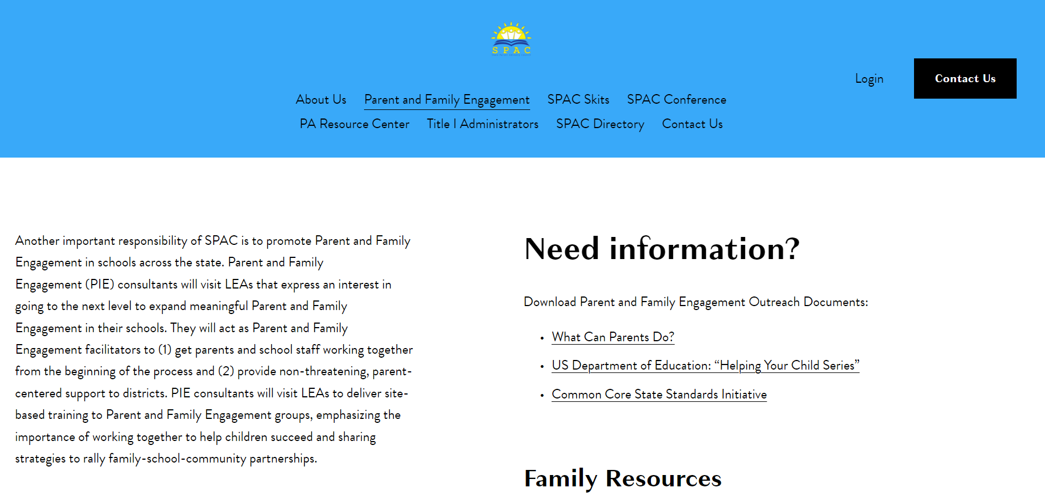
Title I State Parent Advisory Council (SPAC) website: https://www.spac.k12.pa.us/aboutus

Slide 10

Parent surveys
Title I Parent Survey. We are interested to hear suggestions on ways to improve our MTSS (Multi Tiered System of Support) processes, academic program, and family engagement activities.
We will also solicit input on our Title II and Title IV programs. These programs aim to increase the capacity of our district in providing all students access to a well-rounded education as well as improve school conditions for student learning. Please take a few minutes to respond to these surveys when they posted to help us determine how to best expend these funds.
This Photo by Unknown Author is licensed under CC BY

